Slide 1
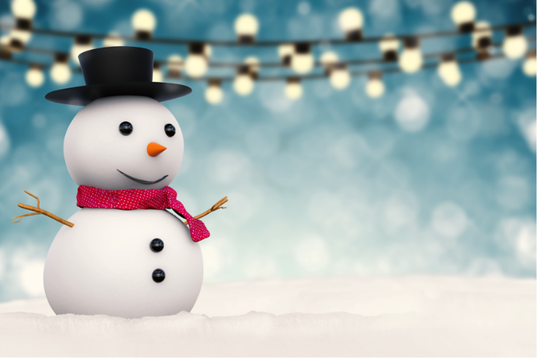
Monday 4th January
Happy New Year everyone!
This PowerPoint is going to include each day’s phonics and grammar activities. This will make sure we are practising our spelling and grammar rules whilst you are working at home. You will need a pen/pencil and a piece of paper.

Slide 2
Let’s start!
Can you remember the 5 vowels?
a e i o u
Time for quick write!
We are now going to practise our words that have a long i sound but are spelt with a y. These words do not have any other vowels e.g try
How many words can you write down which have a y at the end? Did you get these ones below?
fly sky cry by my dry July (exception)

Slide 3
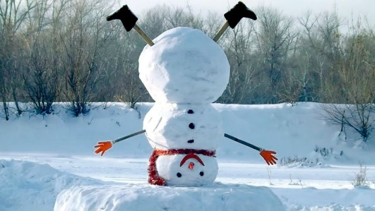
Now we will practise this weeks common exception words (CEW).
Reveal the words
one by one. Look/write/check. bath
last
fast
class
grass
Well done all of you!!

Slide 4
Now we are going to learn our new spelling rule for this week. It is when the j sound is spelt with a g, j, ge or a dge.
Today we are going to read and learn to spell words with a g. What do you notice about the words below?
gem giant gentle ginger giraffe magic gym imagine
Have you spotted the letters that come after the g? e i y

Slide 5
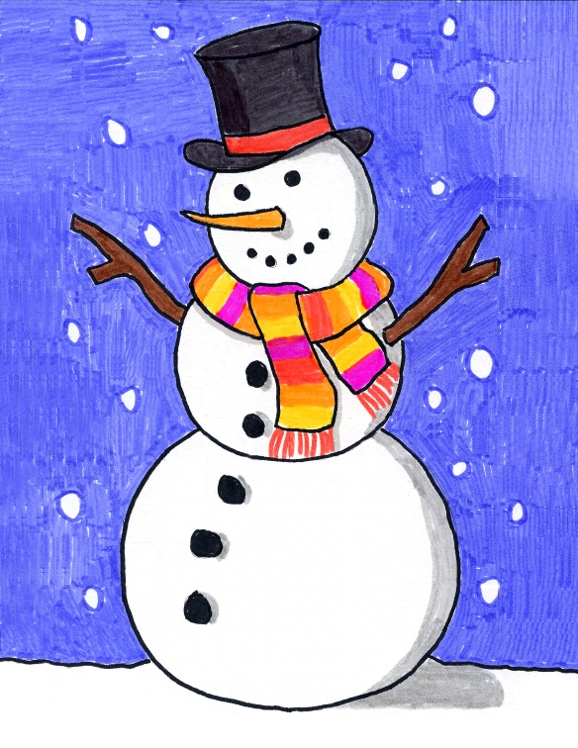
Can you spell the missing word?
The ________________ lived in a huge castle.
The puppy was very calm and ________________.
Gerry the _________________had a very long neck.
The beautiful fairy waved her ______________ wand.
I like to keep fit at the _______________.
Well done everyone!

Slide 6
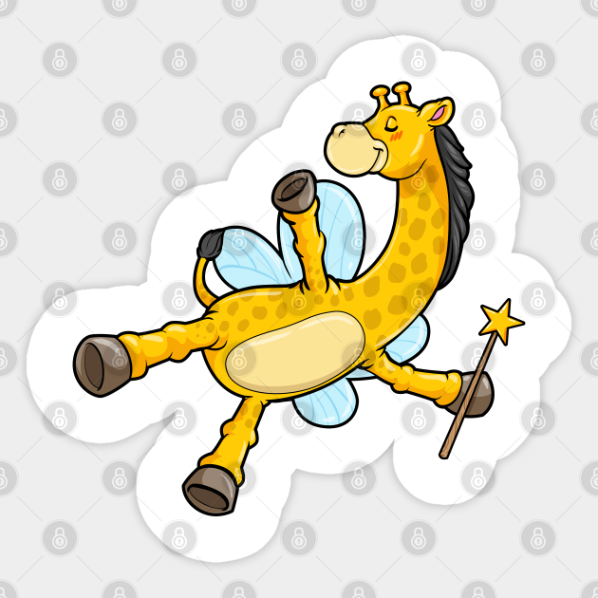
ABC . ! ?
Now make
Up your own sentence using some of your new words!
That’s all for today. Well done!!

Slide 7
Tuesday 5th January
Hello everyone! Today’s quick write is remembering words with the ee sound at the end of them spelt y and ey. Can you make your own lists on your piece of paper?
y ey
happy monkey
Did you think of these?
funny donkey turkey
angry fancy key honey money party merry

Slide 8
Now have a go at practising this weeks CEW. Remember there are 5 of them and that they can be said in different ways. (Mrs Etheridge says them in a different way!)
Go back to slide 3 to check.

Slide 9
Today we will look at words which are spelt with a j.
Look at and read these words.
jumper juggle jam jolly
January juice jungle
What letters come after the j?
a o u

Slide 10
Let’s practise………
Today is the 5th of _____________.
Snakes, monkeys and tigers live in the ______________.
Clowns can ___________ with lots of balls.

Slide 11
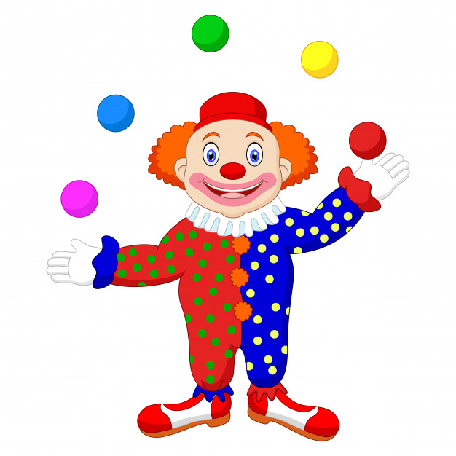
ABC . ! ?
Now make
Up your own sentence using some of your new words!
(It could be a statement, command, question or exclamation).
That’s all for today. Well done!!

Slide 12
Wednesday 6th January
Hello everyone! Today’s activity is writing silly sentences using some of the spelling rules we have learnt this week. We would like you to write your sentences very neatly with clear ascenders and descenders and the rest of the letters the same size. Please ask a grown up to read the sentences to you. You will need your paper and pencil.
The giant and the monkey waved the magic wand.
Can the gentle giraffe juggle in the bath?
The ginger cat jumped on the grass. Well done!

Slide 13
Thursday 7th January
Hello everyone! Today’s quick write is remembering how to add –es to singular words ending in y. Bye bye y hello i.
fairy
story
baby
body
sky

Slide 14
Can you unjumble our CEW words?
tbha salt saft
salsc rasgs
Well done!!!

Slide 15
Today we are going to learn to spell words with the __dge letters.
The letters “-dge” make the /j/ sound at the end of a one-syllable word, followed by one short vowel.
bridge ledge hedge fudge badge
Practise writing these down on your paper.

Slide 16
Can you spell the missing word?
The little boy put his spelling ____________ on his jumper.
The bad tempered troll lived under the rickety
_________________.
The naughty dog chased the ginger cat under
the______________.
Well done everyone!

Slide 17
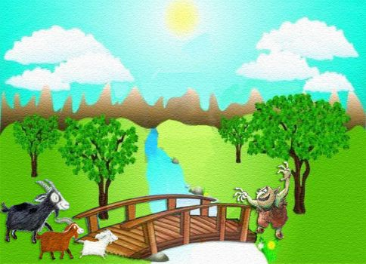
ABC . ! ?
Now make
Up your own sentence using some of your new words!
(It could be a statement, command, question or exclamation).
That’s all for today. Well done!!

Slide 18
Friday8th January
Hello everyone! Today’s quick write is remembering how to write contractions .E.g do not don’t
did not
I am
Where is
She is
Would not

Slide 19
Today we are going to learn to spell words with the __ge letters.
cage village large change
challenge cottage
Practise writing these down on your paper.

Slide 20
Now let’s practise spelling some of the words we have learnt this week!
January
last
stories
bath
monkey
bridge
giraffe
magic
gentle
grass
Well done everyone! We hope you have a lovely weekend.

