Slide 1
Monday 8th February
We hope everyone has had a lovely weekend!
This PowerPoint is going to include each day’s phonics and grammar activities. This will make sure we are practising our spelling and grammar rules whilst you are working at home. You will need a pen/pencil and a piece of paper.

Slide 2
Let’s start! warm towards warn
Today we are going to revise the words with the ‘or’ sound spelt ‘ar’
I wear my jumper to keep ___ ___ ___ ___.
The children walked___ ___ ___ ___ ___ __ __
the shiny sea.
I am going to ___ ___ ___ ___ you that the fire alarm might go off.

Slide 3
Now we will practise this weeks common exception words (CEW).
Reveal the words
one by one. Look/write/check. children
eye
even
money
Well done all of you!!
If you already know your Year 2 CEW look for the Super Spelling Challenge on the
website and practise 6 x words a week. We have some fantastic new badges
for when you come back to school!

Slide 4
This week we are going to focus on words with the suffix _ful
What do you notice about these words? Where is the ‘ful’ suffix?
cheerful useful careful hopeful
That’s right! Did you notice the _ful suffix is at the end of the word. A suffix is letters that are added at the end.

Slide 5
Now lets practise writing some of those words by adding the suffix.
hope
care
cheer
thank
Can you think of any more words with the suffix ful?

Slide 6
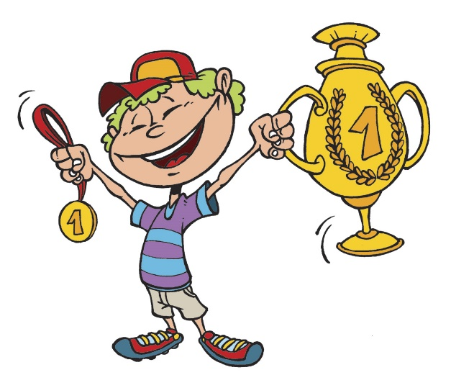
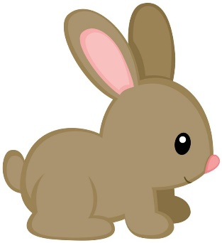
Now put the correct word in these sentences. Try to spell them on your own.
The boy was very __________________ that he’d win a prize.
Be very ___________________ with the baby rabbit.
Please be ________________ on the Zoom call today.
Well done everyone!

Slide 7
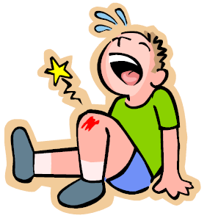
ABC . ! ?
Now make
Up your own sentence using the picture! You will need to use a word beginning with p and ending in ful!
That’s all for today. Well done!!

Slide 8
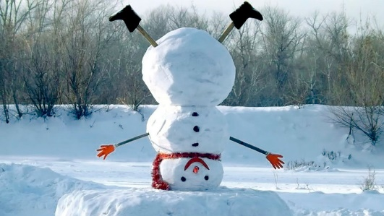
Tuesday 9th February
Hello everyone! Let’s think about the ‘or’ sound spelt ‘a’ before an l or ll
Don’t _____ ______ ______ _____ during the assembly.
Please _____ ______ _____ ______ slowly in the classroom.
____ _____ ______ _____ ______ ______ throw the _____ _____ _____ _____
high in the air. always/ball/walk/talk

Slide 9
Now have a go at practising this weeks CEW. Remember there are 4 of them (or practise your super spellings).
Go back to slide 3 to check.

Slide 10
Now lets practise writing some new words with the suffix _ ful.
Look what happens when the root word ends in a _ y. The y changes to an i.
Hello i, goodbye y!
beauty- beautiful
plenty-plentiful

Slide 11
Look at the clues and write the words with the suffix _ful.
1. When someone has succeeded at something.
2. Something full of wonder.
3. Something with a lot of colour.
4. Someone with a lot of power.
5. Somebody full of hope.
6. When someone tries not to make any mistakes.
7. Someone who helps a lot.
8. When something has a lot of beauty.

Slide 12
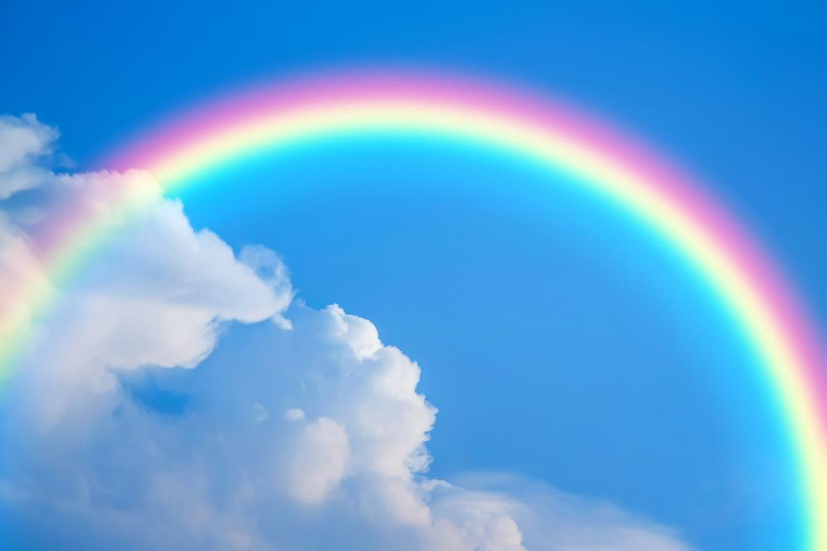
ABC . ! ?
Now make
Up your own sentence using the picture!
That’s all for today. Well done!!

Slide 13
Wednesday 10th February
Hello everyone! Today’s activity is writing silly sentences using some of the spelling rules we have learnt this week. We would like you to write your sentences very neatly with clear ascenders and descenders and the rest of the letters the same size. Please ask a grown up to read the sentences to you. You will need your paper and pencil.
The beautiful rainbow had a pot of gold at the end.
It would be very helpful if you could wash your smelly socks today.
Mrs Etheridge is always cheerful when she has a cup of tea and a kit kat.

Slide 14
Thursday 11th February
Hello everyone! Let’s practise words with the ‘o’ sound spelt ‘a’ after w and qu.
I can ____ ____ _____ _____ _____ ______the ball because I’m very strong.
Please ____ _____ _____ ______ your hands before you eat.
I like to ___ ____ ___ ___ ____ the ___ ____ ___ ___
on the river.

Slide 15
Quickly write your CEW words?
Well done!!!

Slide 16
Today we are going to recap the words we learnt on Monday and Tuesday.
b ___ ___ ___ ___ ___ ful
h____ ____ ____ ____ful
p____ _____ _____ _____ _____ ful
ch ___ _____ ____ful
w ___ ___ ___ ____ ____ ful

Slide 17
Can you write 2 sentences changing the word in red to another word ending in _ful.
e.g
I watched the wonderful rainbow in the sky.
I hoped the children would be cheerful today.
Have a go at changing the verb.

Slide 18
Friday 12th February
Time for some quiz questions!
1.Write the adjective in the sentence below.
The tree was taller than the house.
2. Add two letters to the word happy to make a word that means not happy.
We went to a football game. Our team lost and I was very ___ ___ happy.
.

Slide 19
3. Write down the adverb in the sentence below.
We all sang loudly in assembly.
4. Add a full stop or a question mark.
When will we get to London
When should I start cooking the dinner
When the bell rings, it will be lunchtime

Slide 20
Now lets practise the spellings we have learnt this week. Ask a grown up to read out these spellings for you. If you are finding them tricky remember to write them out a few times!
eye
money
even
children
wonderful
cheerful
beautiful
careful
successful
helpful

Slide 21
Well done everyone! We hope you have a lovely half term.

